Slide 1
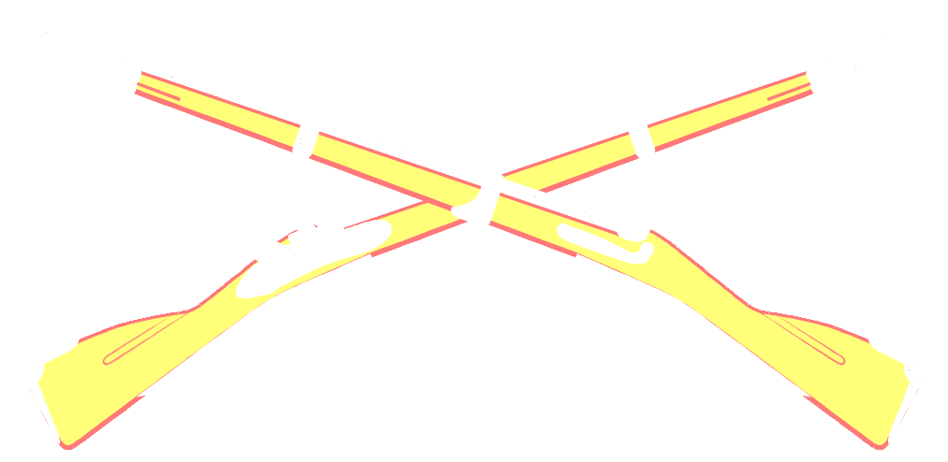
DEFENSIVE
OPERATIONS
They couldn’t hit an elephant at this dist........”
Last words of General John Sedgwick
Battle of Spotsylvania, 1864

Slide 2
TERMINAL LEARNING OBJECTIVE
Action: Conduct defensive operations.
Condition: Given FMs, student handouts, reading assignments, and an instructor in a classroom with training materials.
Standards: Conduct defensive operations IAW
FM 3-21.8, FM 3-21.10, FM 3-0, and
achieve a 70% score on the overall
test.

Slide 3
ADMINISTRATION
Safety None
Risk assessment Low
Environmental None
Evaluation Yes

Slide 4
ENABLING LEARNING OBJECTIVE A
Action: Determine the purpose of the defense.
Conditions: Given FMs, student handouts, reading assignments, and an instructor in a classroom with training materials.
Standards: Determine the purpose of the defense IAW FM 3-21.8, FM 3-21.10FM 3-0, and achieve a 70%score on the overall test.

Slide 5
THE PURPOSE OF
DEFENSIVE OPERATIONS

Slide 6
DEFENSIVE OPERATIONS
PRIMARY REASON
The purpose of defensive operations is to cause an enemy attack to fail and create
conditions favorable for assuming the
offensive.

Slide 7
WHY CONDUCT DEFENSIVE OPERATIONS?
To defeat an enemy attack
To gain time to prepare for other operations
To allow a higher commander to concentrate
forces elsewhere
To control key enemy forces as a prelude to
offensive operations
To retain key or decisive terrain

Slide 8
ENABLING LEARNING OBJECTIVE B
Action: Determine the Characteristics of the Defense.
Condition: Given FMs, student handouts, reading assignments, and an instructor in a classroom with training materials.
Standards: Determine the Characteristics of the Defense IAW FM 3-21.8, FM 3-21.10, FM 3-0, and achieve a 70% pass on the test.

Slide 9
CHARACTERISTICS OF THE DEFENSE
Massing Effects
Flexibility
Preparation
Security
Disruption

Slide 10
PREPARATION
Arrive in the battle area before the attacker and take advantage of:
Use METT-TC to identify potential friendly and enemy weaknesses
Synchronize the concept of the operation with all available resources
Ensure 360 degree security with WPN systems
Begin R&S plan immediately

Slide 11
MASSING EFFECTS
Defenders seek to mass the effects of overwhelming combat power where they choose and shift it to support the decisive operation, or Main Effort (ME).

Slide 12
DISRUPTION
Disrupts the attacker’s tempo and synchronization
by countering his initiative and preventing him from
massing overwhelming combat power.
Interrupts the attacker’s fire support, logistical support, and Command and Control (C2).
Defenders use spoiling attacks before enemies can focus combat power, and counterattacks before they can consolidate any gains.

Slide 13
FLEXIBILITY
The defender must be agile enough to avoid the
attackers blows and then strike back effectively.
Derived from sound preparation and effective C2.
Ability to shift the Main Effort (ME).
Aggressive Recon and Surveillance (R&S).
Retention of a reserve.
Preparation in depth such as alternate and supplementary positions.

Slide 14
SECURITY
Never permit the enemy to acquire an unexpected
advantage.
Security operations help deceive the enemy as to friendly locations, strengths, and weaknesses.

Slide 15
TYPES OF DEFENSIVE OPERATIONS
MOBILE DEFENSE
AREA DEFENSE
RETROGRADE

Slide 16
ENABLING LEARNING OBJECTIVE C
Action: Identify factors of defensive planning.
Condition: Given FMs, student handouts, reading assignments, an instructor, and a classroom with training materials.
Standards: Identify factors of defensive planning IAW FM 3-21.8, FM 3- 21.10, FM 3-0, and achieve a 70% score on the overall test.
Notes:
.

Slide 17
DEFENSIVE PLANNING
Where / How to defend
Sequence of the defense
Types of positions
Occupation plan
Security plan
Reserve
Fire control measures

Slide 18
WHERE TO DEFEND
DEFENSIVE TECHNIQUES:
Defend in Sector
Defend from a Battle Position
Defend from a Strongpoint
Defend a Perimeter
Defense of a Reverse Slope

Slide 19
DEFEND IN SECTOR
Consists of sectors.
Positions are arrayed in depth.
Strength of this defense is flexibility.
Enemy oriented, not terrain oriented.
Very effective as it allows the enemy to expose his flanks, Command and Control, and Combat Support (CS) assets.

Slide 20
DEFEND FROM A BATTLE POSITION
More linear and centralized.
Achieves surprise and allows maneuver between battle positions (BPs).
Effective in concentrating combat power
into engagement areas (EAs).
Mutually supporting battle positions cover likely enemy avenues of approach and vehicular movement.

Slide 21
PERIMETER DEFENSE
Platoons prepare a perimeter defense when there are no friendly units adjacent to it.
Disperse the platoon into a circular configuration for 360 degree security; actual shape is terrain dependent.

Slide 22
DEFEND A STRONG POINT
Hold key or decisive terrain.
Block an avenue of approach.
Canalize the enemy.
A strong point is defended until the unit is formally relieved or ordered out.
A strong point defense includes:
Reinforcing each individual fighting position to withstand small-arms fire, mortar fire, and artillery fragments.
The stockpiling of food, water, ammunition, tools, and medical supplies.
Construct formidable obstacles and minefields.
Construct range cards for each position and confirm them by fire.

Slide 23
DEFEND FROM A
REVERSE SLOPE
A reverse slope defense masks friendly forces behind the crest of a hill from enemy direct fire and ground observation.
ADVANTAGES DISADVANTAGES
Close contact / Surprise Fields of Fire are short
CAS and IDF degraded Degrade observation
Exposes the tops of vehicles Enemy assaults downhill
Can use dummy positions Forward obstacles are only covered by direct fire

Slide 24
SEQUENCE OF THE DEFENSE
Prepare for combat
Move to defensive positions
Establish defensive positions
Locate the enemy
Initiate contact / Actions on enemy contact
Fight the defense
Consolidate & Reorganize

Slide 25
CONSIDERATIONS
Defend in depth
Create mutual support as much as possible
Use passive and active security measures
Make maximum use of key weapon systems (to include indirect fire weapon systems)
Decide on obstacle composition and location
Emplace machine-guns along likely dismounted avenues of approach
Emplace anti-armor weapons against likely mounted avenues of approach
Make maximum use of offensive action

Slide 26
TYPES OF BATTLE POSITIONS
Primary
Alternate
Supplementary

Slide 27
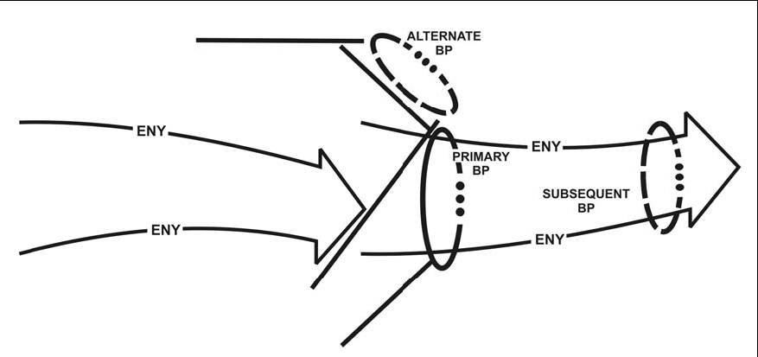
Primary, Alternate and subsequent battle positions example

Slide 28
OCCUPATION OF THE DEFENSE

Slide 29
OCCUPATION PLAN
WHY?
Prevents confusion
Establishes security quickly
Allows parallel planning
Allows priority of work to commence ASAP

Slide 30
PRIORITY OF WORK
Establish security
Position key weapons
Clear fields of fire and prepare range cards
Prepare fighting positions
Emplace obstacles and mines
Prepare alternate positions
Establish work rest plan
Stockpile ammunition, food, and water

Slide 31
SECURITY PLANS
Active Measures
Recon and Surveillance patrols
Stand-To / Stand-Down
Ground Surveillance Radar (GSR)
Passive Measures
Noise, Light & Litter Discipline
Radio Silence
Camouflage
Counter-reconnaissance

Slide 32
RESERVE
At platoon level, the reserve may consist of a
rifle squad, fire team, or the platoon
headquarters element.
Some situations require committed forces to
"be prepared" to act as a reserve.
The primary purpose of the reserve is to
regain the initiative through counterattack.

Slide 33
DIRECT
&
INDIRECT FIRE
CONTROL MEASURES

Slide 34
ENABLING LEARNING OBJECTIVE D
Action: Identify employment considerations of weapons systems in the defense.
Condition: Given FMs, student handouts, reading assignments, an instructor, and a classroom with training materials.
Standards: Discuss the employment of weapon systems in the defense IAW FM 3-21.8, FM 3-21.10, and
FM 7-90.

Slide 35
DIRECT FIRES
Types of Direct fire available:
Machine guns
M203
AT-4
Close Air Support
Aids to control:
Engagement Areas
Sectors of Fire
Target Reference Points (TRP)
Engagement Priorities

Slide 36
WHAT IS AN ENGAGEMENT AREA?
Where the commander intends to trap and destroy an enemy force using the massed fires of all available weapons.

Slide 37
ENGAGEMENT AREA
Determine where you want to kill the enemy—which is usually along likely enemy avenues of approach.
Plan & emplace obstacles.
Emplace direct fire weapons.
Plan indirect fires.
Rehearse the execution of operations in the
engagement area.

Slide 38
INDIRECT FIRE ASSETS
Types of indirect fire available:
M203
Mortars
Artillery
Naval gun fire
Aids to control:
Targets
Final protective fire (FPF)
Priority targets

Slide 39
NORMAL FPF DIMENSIONS
Size Type # of Mortars Width Depth
60mm M224 2 60 30
81mm M252 4 120 40
120mm M120 3 180 60
120mm M120 6 360 60
Final Protective Fires: FPFs are preplanned barriers of both direct and indirect
Fires designed to protect friendly troops from an enemy dismounted assault.
FM 7-90, CHAP 5, PG 5-4

Slide 40
FPF POSITIONING
81mm
FPF
AB0011
AB0012
MACHINE
GUN FPL
60mm
FPF
Notes:
NEXT SLIDE IS NEXT TO LAST…PREPARE TO SUMMARIZE

Slide 41
TERMINAL LEARNING OBJECTIVE
Action: Conduct defensive operations.
Condition: Given FMs, student handouts, reading assignments, and an instructor in a classroom with training materials.
Standards: Conduct defensive operations IAW
FM 3-21.8, FM 3-21.10, FM 3-0, and
achieve a 70% score on the overall
test.

